Slide 1
Istituto Comprensivo Cosenza III
“Via Negroni”
Cosenza
ERASMUS+ KA101
“Noi per una scuola Inclusiva, Innovata, Internazionale”
Codice 2018-1-IT02-KA101-046929
CUP - C89F19000020006

Slide 3
Content and Language Integrated Learning
CLIL (Content and Language Integrated Learning) è un approccio metodologico rivolto all’apprendimento integrato di competenze linguistico-comunicative e disciplinari in lingua straniera.
La metodologia CLIL rappresenta una sfida e una grande opportunità: sia per chi conosce già l’inglese e ha buone competenze, sia per chi da anni accarezza l’idea di impararlo.

Slide 4
ATTIVITA’ CLIL
SUL GIOCO DEL BASKET
DOCENTI COINVOLTI: MIRANDA OLIVERIO, ANGELA MARIA SIRIANNI, TINA SPIZZIRRI MARZO
CLASSE COINVOLTA: I B - SCUOLA SECONDARIA DI I GRADO
LESSON PLAN/CONTENT:
PREPOSITIONS OF PLACE
THERE IS/THERE ARE
QUESTION WORDS
PRESENT SIMPLE
VOCABULARY RELATED TO SPORTS

Slide 5
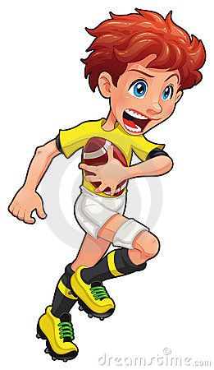
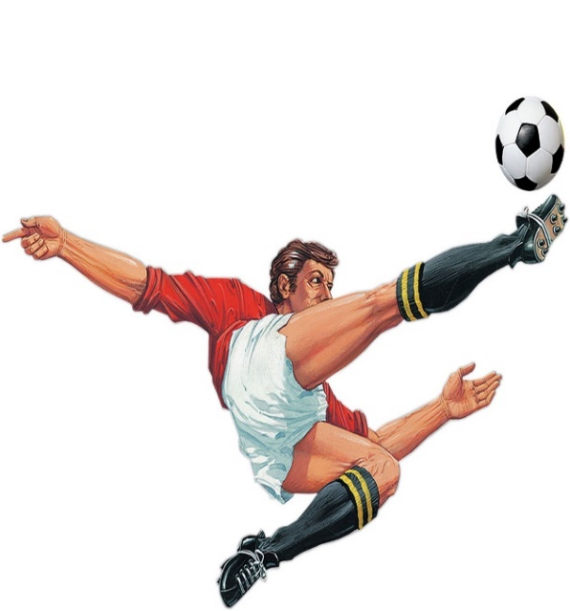
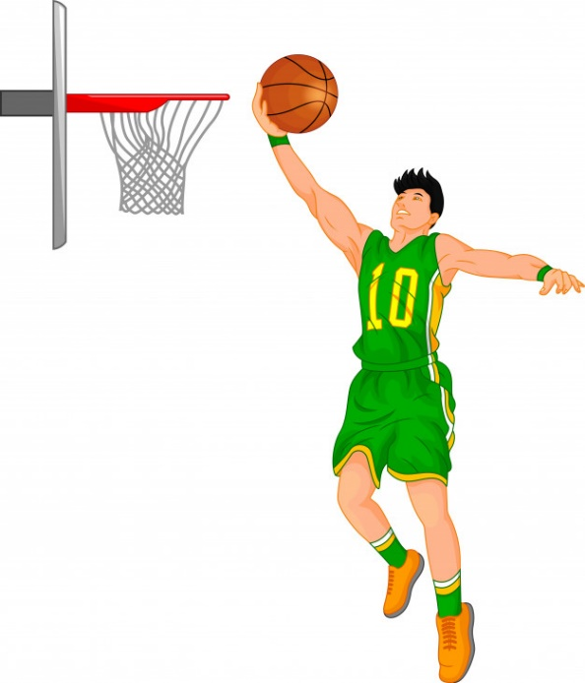
WHAT CAN YOU SAY ABOUT THESE FAMOUS SPORTS?
VIDEO: HOW TO PLAY BASKETBALL
LEARNING THE BASIC RULES OF BASKETBALL (YOU TUBE):
https://www.youtube.com/watch?v=XbtmGKif7Ck

Slide 6
The basic rules of basketball GAP FILL
Basketball is played on a rectangular ----- which is 22 to 28 meters long and 13 to 15 meters wide. At each end of the court there’s a basket fixed on a panel suspended 3.05 ------ above the ground. It’s 45 centimeters ----. Two teams of ---- players compete over four quarters of 10 minutes each. A 15 ------ halftime takes place between the second and the third -------. The objective of both teams is to put the ball through the opponent’s hoop to score as many points as possible. A scored shot called a field goal is worth two points or ----- if the player has thrown the ball from outside the Three-Point Arc. The team with the high score at the end of the match ---- the game. In case of a tie the ----- play 5 minute rounds in overtime until one team wins. To get the ball across the court players can only move while dribbling or pass the ball. They are only allowed to use their hands in offense. Players can be sanctioned by violation which leads to a turnover from behind the opponent’s baseline. In case of illegal contact, players can be ---------- by fouls. Fouls are sanctioned by turnovers or free shots for the opponent. Free throws are shot from a line placed near the edge of the key and are ----- one point. The key, also called Free Throw Lane, is the rectangular area drawn beneath both hoops and, each time out, the coach may make substitutions. There is no limit to the number of ------- who can be substituted. | wide court five meters three quarter minute teams wins sanctioned players worth

Slide 7
PUNCTUATE THE TEXT AND ADD CAPITALS.
basketball is played on a rectangular court which is 22 to 28 meters long and 13 to 15 meters wide at each end of the court there’s a basket fixed on a panel suspended 3.05 meters above the ground it’s 45 centimeters wide two teams of five players compete over four quarters of 10 minutes each a 15 minute halftime takes place between the second and the third quarter the objective of both teams is to put the ball through the opponent’s hoop to score as many points as possible a scored shot called a field goal is worth two points or three if the player has thrown the ball from outside the three-point arc the team with the high score at the end of the match wins the game in case of a tie the teams play 5 minute rounds in overtime until one team wins to get the ball across the court players can only move while dribbling or pass the ball they are only allowed to use their hands in offense players can be sanctioned by violation which leads to a turnover from behind the opponent’s baseline in case of illegal contact players can be sanctioned by fouls fouls are sanctioned by turnovers or free shots for the opponent free throws are shot from a line placed near the edge of the key and are worth one point the key also called free throw lane is the rectangular area drawn beneath both hoops and each time out the coach may make substitutions there is no limit to the number of players who can be substituted

Slide 8
Canestro Basketball hoop
Palla Ball
Squadra Team
Allenatore Coach
Campo Court
Arbitro Referee
Linea di fondo campo Baseline
Fallo Foul
Panchina Bench
Avversario Opponent
Insieme delle capacità di controllo della palla Ball handling
Prendere la palla dopo un canestro mancato Rebound
Tiro Shot
Attacco Offense
Tiro in terzo tempo Layup shot

Slide 9
Palleggio Dribble
Passaggio Pass
Difesa Defense
Cambio direzione (in palleggio) Crossover dribble
Cambio velocità Change of speed
Palleggio mano destra/sinistra Dribble right/left hand
Cambia mano in palleggio Change hand dribbling
Ruba la palla Steal the ball
Marca il tuo avversario Find your opponent
Passaggio consegnato (in mano) Hand off
Guarda il canestro Look at the hoop
Passare la palla dal petto con 2 mani Two hands chest pass
Palleggia mentre corri Dribble and run
Rimettere la palla in gioco da fuori campo Throw-In
Infrazione di passi Travelling violation

Slide 10
NOW USE YOUR ANSWERS TO WRITE A SUMMARY OF THE TEXT. ADD THE GREEN WORDS IN THE QUESTIONS TO THE ANSWERS. THE WORDS IN RED IN THE QUESTION SUBSTITUTE THE WORDS IN RED IN THE ANSWER.
ANSWER THE QUESTIONS.
HOW MANY TEAMS ARE THERE IN A BASKETBALL MATCH? | THERE ARE ___ TEAMS.
HOW MANY PLAYERS ARE THERE IN A TEAM? | THERE ___ FIVE PLAYERS.
HOW MANY QUARTERS ARE THERE IN A MATCH? | _____ ARE FOUR QUARTERS.
HOW MANY MINUTES ARE THERE IN A BASKETBALL QUARTER? | THERE ___ TEN _______.
HOW MANY POINTS IS A FIELD GOAL WORTH? | IT IS WORTH ___ POINTS.
HOW MANY POINTS IS A BALL SHOT FROM OUTSIDE THE THREE-POINT ARC WORTH? | IT IS _______ THREE POINTS.
HOW MANY POINTS ARE FREE SHOTS FROM A LINE NEAR THE EDGE OF THE KEY WORTH? | THEY ___ _____ ONE POINT.
HOW MANY SUBSTITUTIONS MAY THE COACH MAKE? | THERE’S __ LIMIT TO SUBSTITUTIONS THE COACH MAY ____.

Slide 11
AND NOW…..........
DRAW A RECTANGULAR, BASKETBALL COURT
DRAW TWO TEAMS IN THE COURT
DRAW A DRIBBLING PLAYER
DRAW A PLAYER WHO PASSES THE BALL
DRAW THE KEY (FREE THROW LANE)

Slide 12
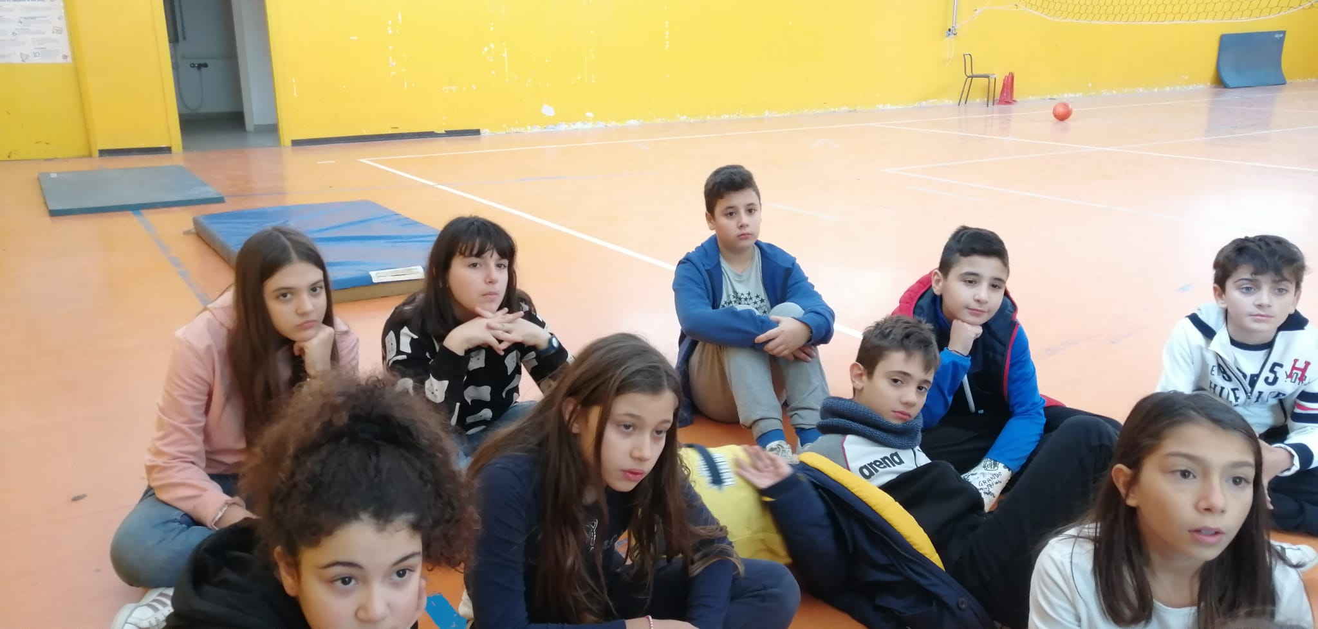
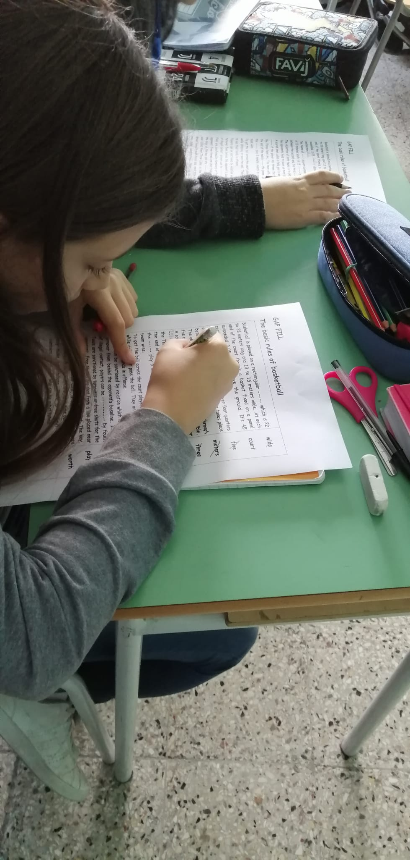
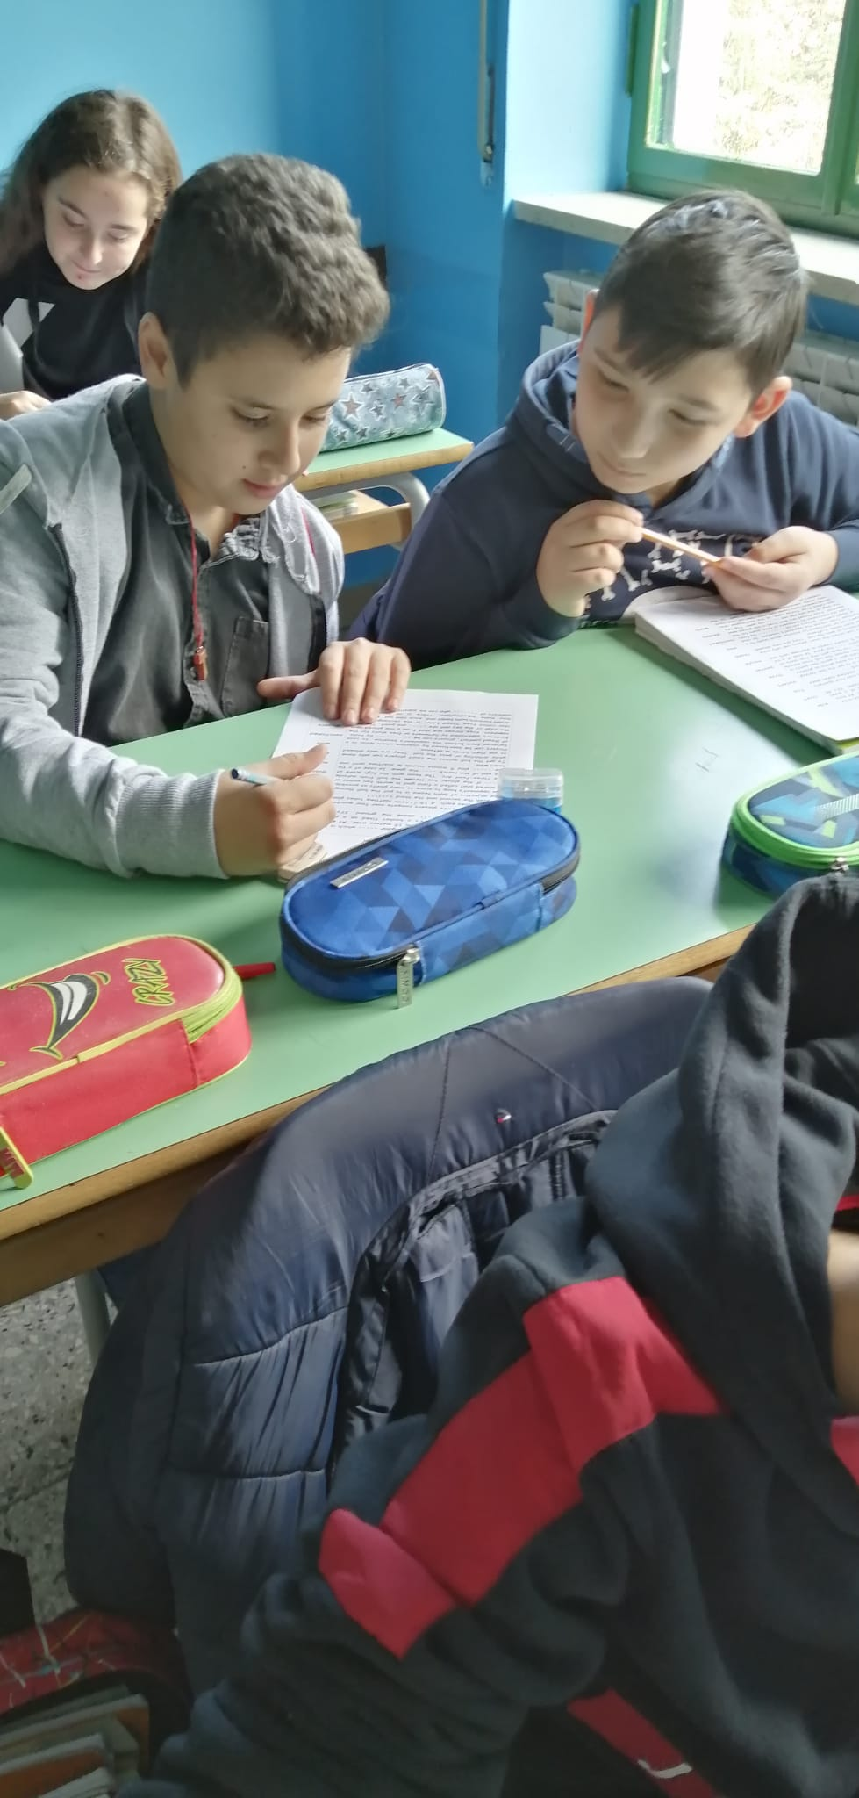

Slide 13
LET’S GO AND PLAY
1 C | O | U | 2 R | T |  | 3 F | 4 I | V | 5 E
O |  |  | E |  | 6 B |  | N |  | V
7 A | T |  | 8 F | R | E | E |  |  | E
C |  | 9 P | E |  | N |  | 10 T | E | N
H |  |  | R |  | C |  | E |  | I
 | 11 S |  | E |  | H |  | A |  | N
12 T | H | R | E | E |  |  | M |  | G
 | O |  |  |  | 13 H |  |  | 14 D
 | 15 T | U | 16 R | N | O | V | E | R
 | S |  | I |  | O |  |  | I
17 B |  |  | G |  | P |  | 18 N | B | A
A |  |  | 19 H | E |  | 20 G |  | B
21 L | E | F | T |  | 22 F | O | U | L | 23 S
L |  |  |  |  |  |  | 24 K | E | Y

Slide 14
ACROSS
1. Basketball is played on a -----.
3. The number of players in a basketball team.
7. Look -- the hoop!
8. ---- throws are worth one point.
9. Physical Education (abbr.)
10. How many minutes are there in a basketball quarter?
12.How many points is a ball shot from outside the Three-Point Arc worth?
15.Fouls can be sanctioned by a --------.
18.Acronym for National Basketball Association.
19.Avery Antonio Bradley jr. is a very good basketball player.-- plays with the L.A. LAKERS.
21.You can dribble ---- hand.
22.They’re always sanctioned.
24.It’s the rectangular area drawn beneath both hoops.
DOWN
1. He/she trains a team.
2. The ------- sanctions the players when they commit fouls.
4. Preposition of place.
5. Seven p.m. or seven in the -------.
6. Those who don’t play sit on a -----.
9. Five players are a basketball ----.
11.Fouls can be sanctioned by free -----.
13.The basketball player puts the ball through the ----.
14. The basketball player can only ------- and run.
16. You can dribble ----- hand.
17.Players can only move while dribbling or pass the ----.
20.Let’s -- and play!!!
23.Sincerely Yours (abbr.)

Slide 15
FILL IN THE BLANK SPACES. USE THE FOLLOWING WORDS. PITCH, RECTANGULAR (3), COURT, TEAM SPORT (3), FIFTEEN, FOOTBALL, GOAL, NO LIMITS TO SUBSTITUTIONS, FIVE, LIMITS TO SUBSTITUTIONS, VOLLEYBALL, ELEVEN, BASKETBALL, SIX.
BASKETBALL | FOOTBALL | VOLLEYBALL | RUGBY
 |  | RECTANGULAR
COURT | PITCH
 | TEAM SPORT
_____ PLAYERS | ____ PLAYERS | ____ PLAYERS | ______ PLAYERS
NO LIMITS TO SUBSTITUTIONS | LIMITS TO SUBSTITUTIONS
 |  |  | OVAL BALL
HOOP |  | NET | THE RUGBY NETWORK
NOW WRITE A SHORT PARAGRAPH FOR EACH SPORT. HERE IS A MODEL TO FILL IN AND FOLLOW:
Basketball is played on a ____________ _________.
It is a ______ __________.
There are __________ players in a team.
There are ___ ___________ ___ _________________.
It is played with a ________________.
There are two ________ in the court.

Slide 16
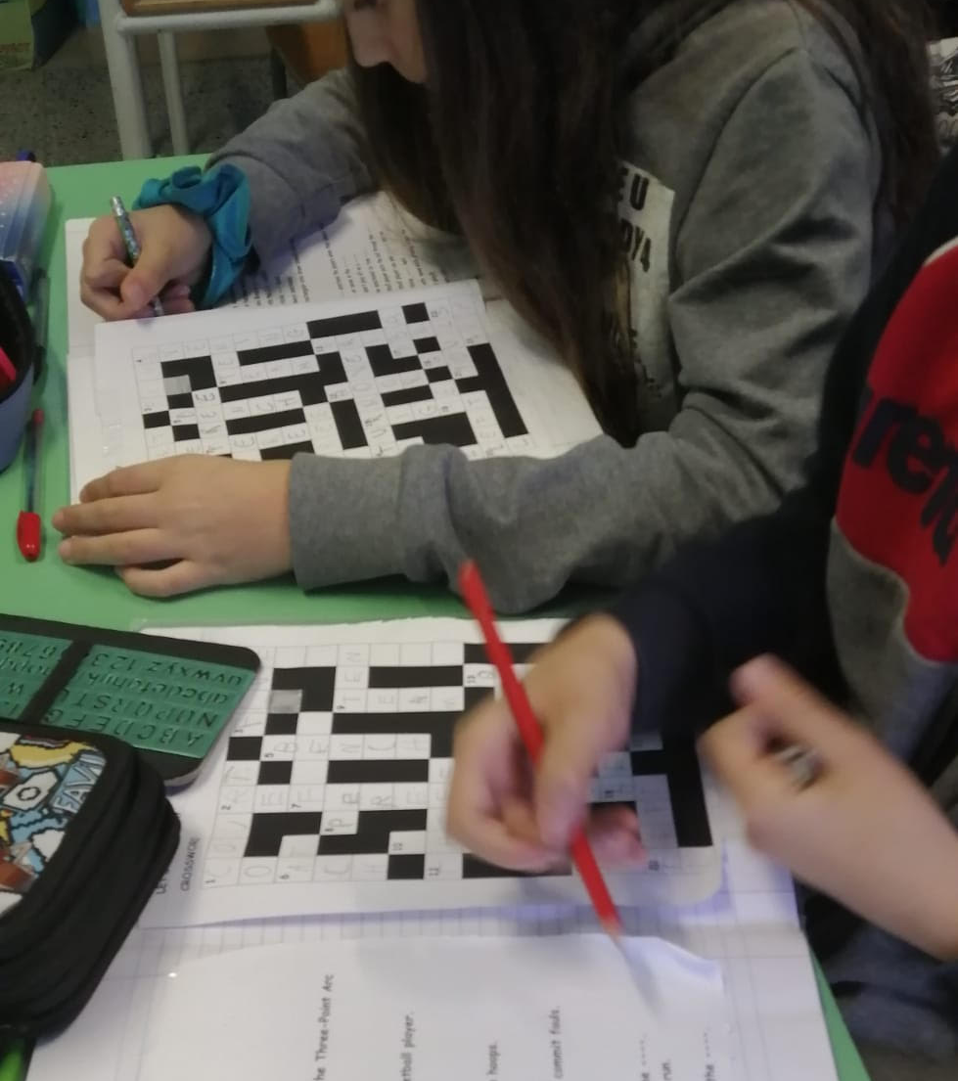
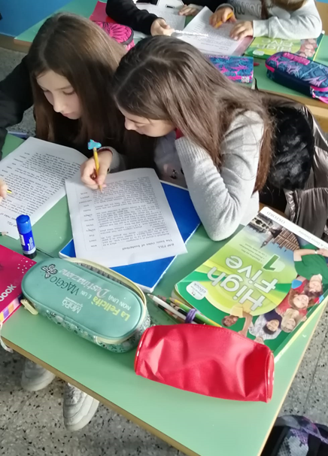

Slide 18
